Slide 2
14 Bell‘s inequalities
Quantum mechanics is statistical theory
→ probabilistic statements about ensembles of identically prepared quantum systems
→ Behavior of single quantum systems seems to contradict common sense
Schrödinger (1952): “… we never experiment with just one electron or atom or molecule. In thought experiments we sometimes assume we do; this invariably entails ridiculous consequences.”
But in modern Quantum optics
→ realize such “thought experiments” probabilistic and test “ridiculous consequences”

Slide 3
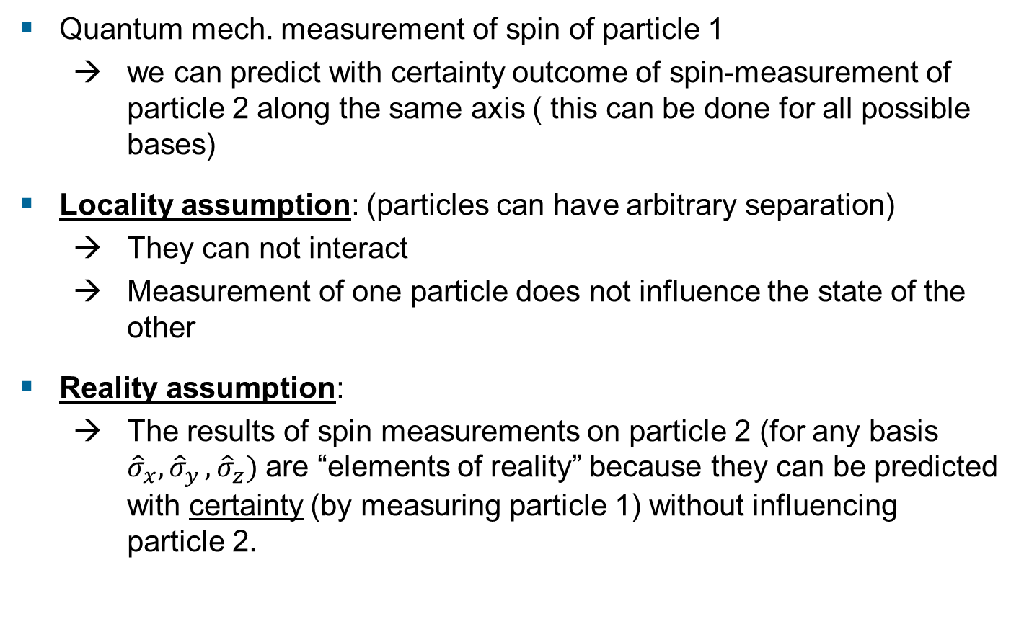
EPR argument
Quantum mech. measurement of spin of particle 1
→ we can predict with certainty outcome of spin-measurement of particle 2 along the same axis ( this can be done for all possible bases)
Locality assumption: (particles can have arbitrary separation)
→ They can not interact
→ Measurement of one particle does not influence the state of the other
Reality assumption:
→ The results of spin measurements on particle 2 (for any basis ${\hat{σ}}_{x}{, \hat{σ}}_{y},{\hat{σ}}_{z})$ are “elements of reality” because they can be predicted with certainty (by measuring particle 1) without influencing particle 2.
Einstein, B. Podolsky, N. Rosen, Can quantum-mechanical description
of physical reality be considered complete?, Phys. Rev. 47, 777 (1935)

Slide 4
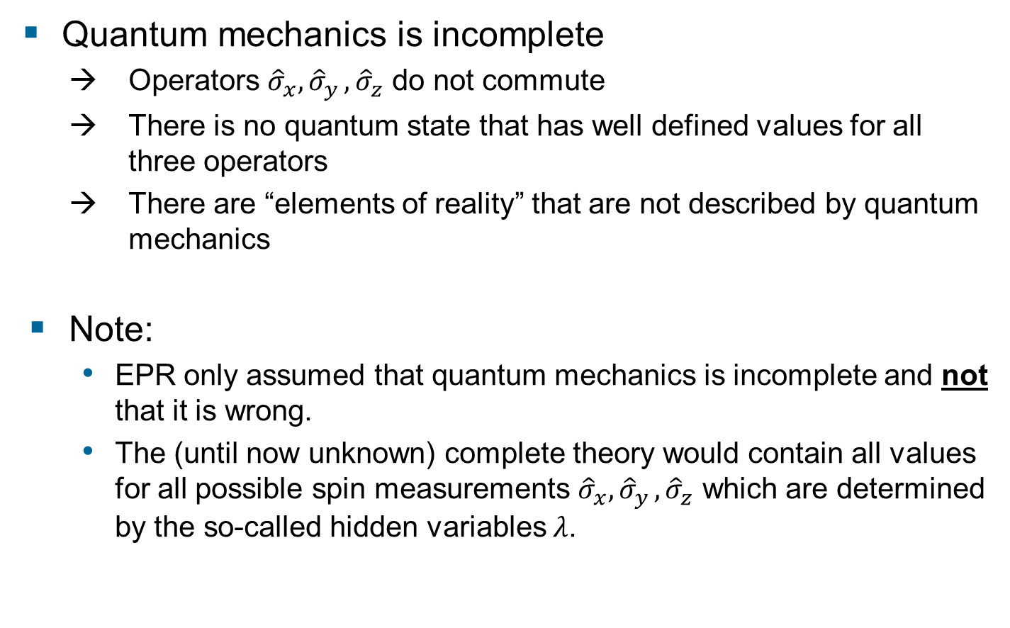
EPR conclusion
Quantum mechanics is incomplete
→ Operators ${\hat{σ}}_{x}{, \hat{σ}}_{y},{\hat{σ}}_{z}$ do not commute
→ There is no quantum state that has well defined values for all three operators
→ There are “elements of reality” that are not described by quantum mechanics
Note:
EPR only assumed that quantum mechanics is incomplete and not that it is wrong.
The (until now unknown) complete theory would contain all values for all possible spin measurements ${\hat{σ}}_{x}{, \hat{σ}}_{y},{\hat{σ}}_{z}$ which are determined by the so-called hidden variables $λ$.
Einstein, B. Podolsky, N. Rosen, Can quantum-mechanical description
of physical reality be considered complete?, Phys. Rev. 47, 777 (1935)

Slide 5
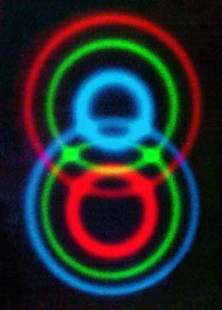
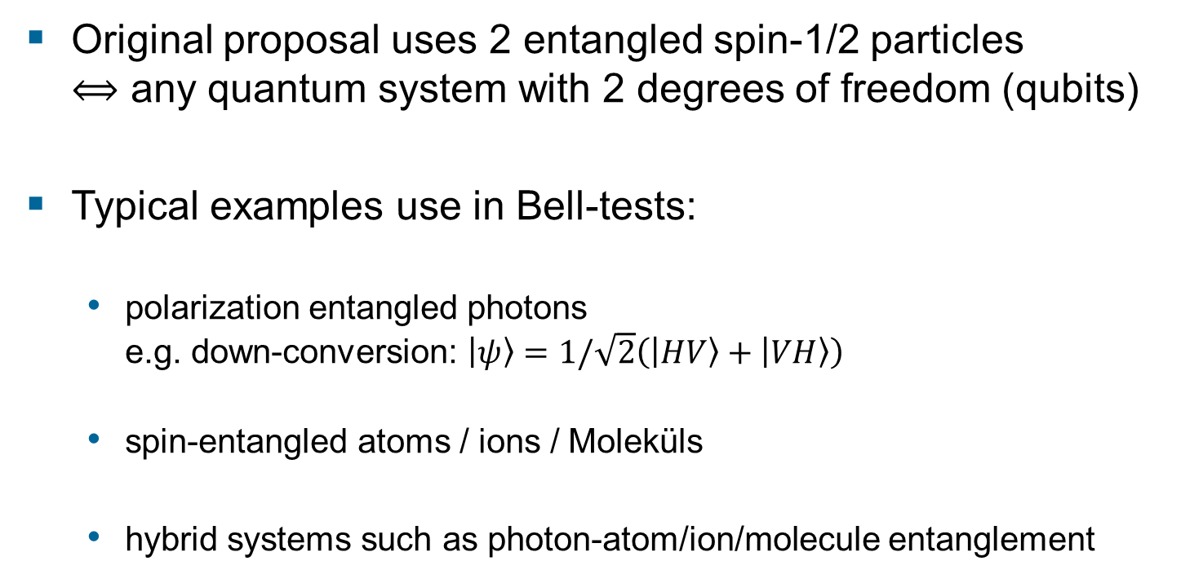
Experimental tests of Bell’s inequality
Original proposal uses 2 entangled spin-1/2 particles $⟺$ any quantum system with 2 degrees of freedom (qubits)
Typical examples use in Bell-tests:
polarization entangled photons e.g. down-conversion: $\left.\left|ψ\right.\right\rangle =1/\sqrt{2}\left(\left.\left|HV\right.\right\rangle +\left.\left|VH\right.\right\rangle \right)$
spin-entangled atoms / ions / Moleküls
hybrid systems such as photon-atom/ion/molecule entanglement

Slide 6
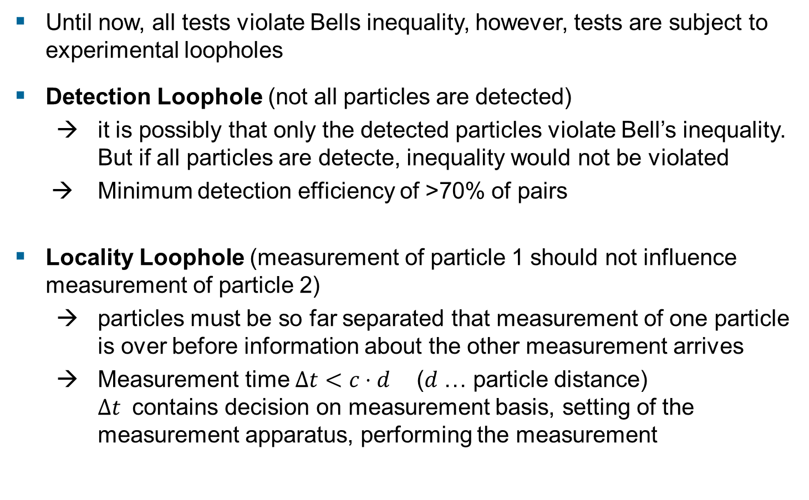
Loopholes
Until now, all tests violate Bells inequality, however, tests are subject to experimental loopholes
Detection Loophole (not all particles are detected)
→ it is possibly that only the detected particles violate Bell’s inequality. But if all particles are detecte, inequality would not be violated
→ Minimum detection efficiency of >70% of pairs
Locality Loophole (measurement of particle 1 should not influence measurement of particle 2)
→ particles must be so far separated that measurement of one particle is over before information about the other measurement arrives
→ Measurement time $Δt<c⋅d$ ($d$… particle distance) $Δt$ contains decision on measurement basis, setting of the measurement apparatus, performing the measurement

Slide 7
Loopholes
1972 Freedman, Clauser, Phys. Rev. Lett. 28, 938–941
1982 Aspect, Dalibard, Roger, Phys. Rev. Lett. 49, 1804
1998 Weihs, et al., Phys. Rev. Lett. 81, 5039
2001 Rowe, et al. Nature 409, 791
2015 Hensen, Nature 526, 682
entangled photons
Locality loophole closed
Locality loophole closed
entangled ions
Detection loophole closed
entangled molecules
(with a distance of 1.3 km)
Both loophole closed

Slide 8
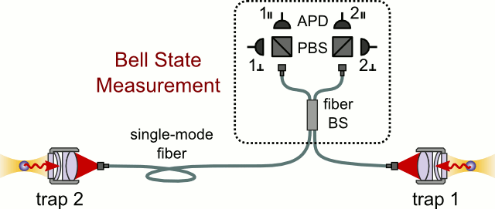
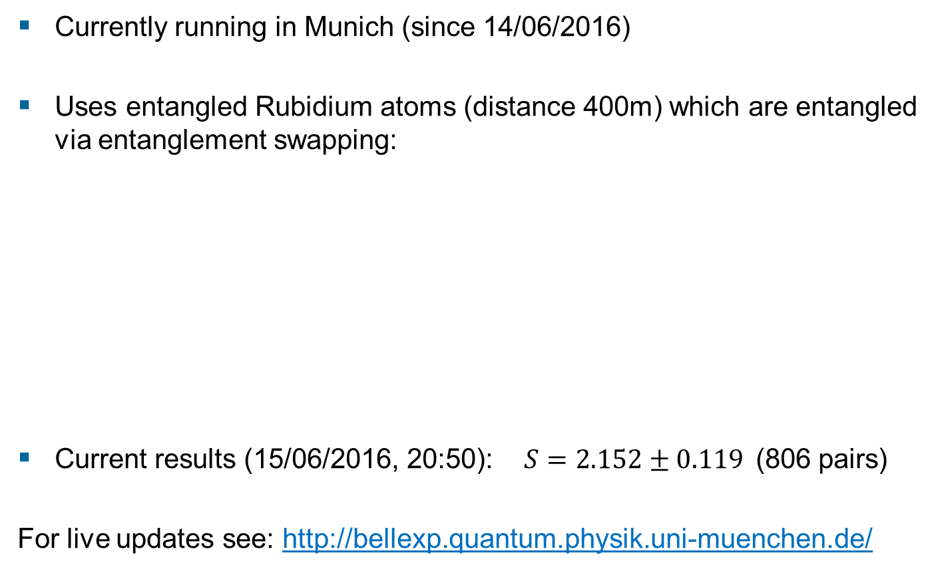
A second loophole-free experiment
Currently running in Munich (since 14/06/2016)
Uses entangled Rubidium atoms (distance 400m) which are entangled via entanglement swapping:
Current results (15/06/2016, 20:50): $S=2.152±0.119$(806 pairs)
For live updates see: http://bellexp.quantum.physik.uni-muenchen.de/

